Slide 1
IMAGE RECOGNITION WITH IBM CLOUD VISUAL RECOGNITION

Slide 2
Introduction to Face Recognition
Face recognition technology has become increasingly popular in recent years due to its ability to identify individuals based on their facial features. This technology has various applications, including security systems, social media platforms, and marketing research. The technology works by analyzing unique facial features such as the distance between the eyes, nose, and mouth to create a digital representation of a face, which can then be compared to a database of known faces to identify a match.

Slide 3
Emotion Detection
Emotion detection is a technology that uses facial recognition to identify emotions on a person's face. This is done by analyzing facial expressions, such as the shape of the mouth or the position of the eyebrows. Emotion detection can be used in various industries, including healthcare, marketing, and entertainment.

Slide 4
Applications of Emotion Detection
One of the most common applications of emotion detection is in healthcare, where it can be used to monitor patients' emotional states during therapy or treatment. It can also be used in marketing to gauge customers' reactions to advertisements or products. In entertainment, emotion detection can be used to personalize recommendations for movies or TV shows based on viewers' emotional responses.

Slide 5
Sentiment Analysis
What is Sentiment Analysis?
Sentiment analysis is a technique used to identify and extract subjective information from text, speech, or images. In the context of face recognition, sentiment analysis can be used to determine the emotional state of an individual based on their facial expression.
Applications of Sentiment Analysis in Face Recognition
Sentiment analysis can be used in a variety of applications, such as improving customer service by detecting the emotions of customers during interactions, or in security systems to detect potential threats based on facial expressions.

Slide 6

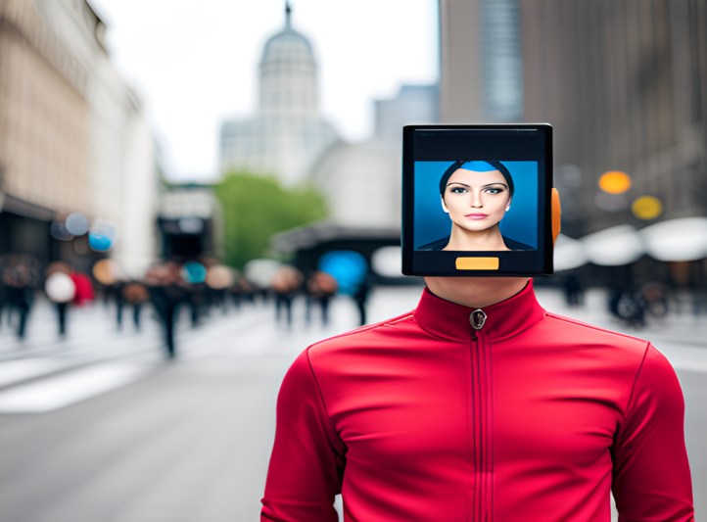
Use Cases of Face Recognition
Security and Law Enforcement
Facial recognition technology is being used by law enforcement agencies for identifying suspects and missing persons, as well as for security purposes in public places like airports and train stations.
Marketing and Advertising
Facial recognition technology is being used by companies for personalized marketing and advertising, where they analyze the facial expressions of customers to determine their emotions and preferences.

Slide 7
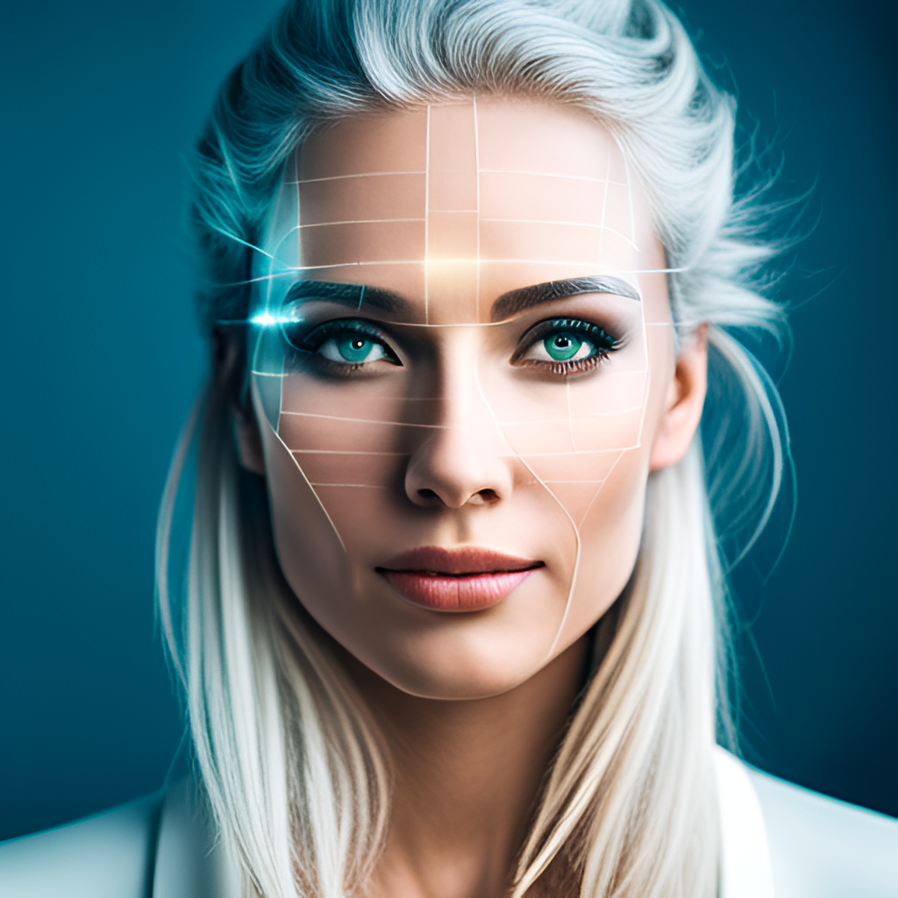
Ethical Considerations
As with any technology, face recognition with emotions and sentiments raises ethical concerns. One of the most pressing issues is privacy. The use of facial recognition technology can potentially lead to mass surveillance, tracking.

Slide 8
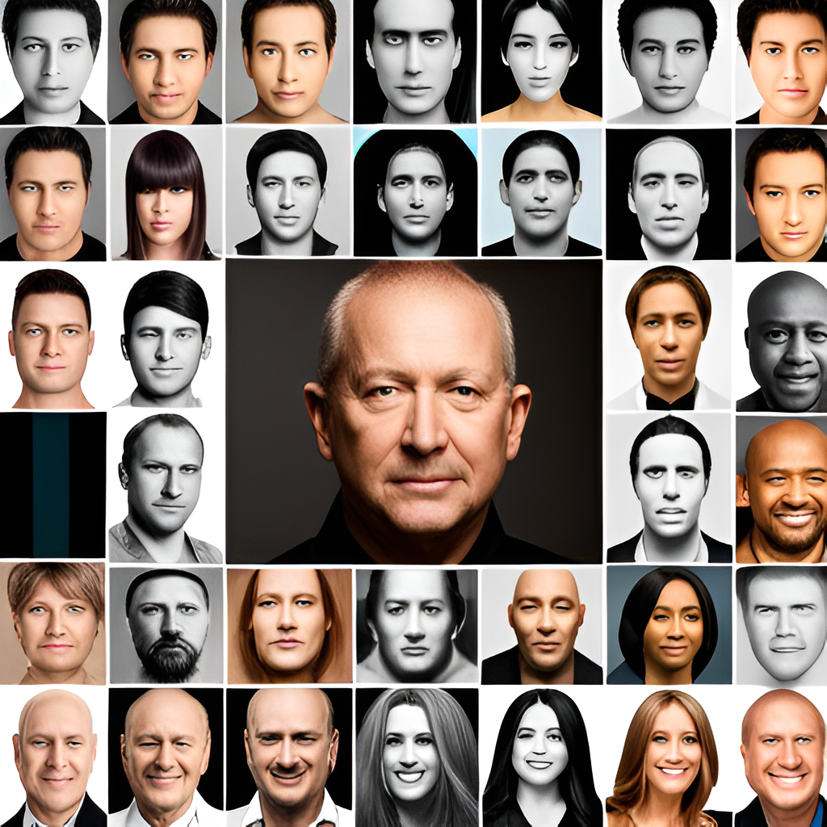
Future of Face Recognition
The future of face recognition technology is bright, with many potential applications and advancements on the horizon. One of the most exciting developments is the integration of facial recognition with other technologies, such as artificial intelligence and machine learning, which will allow for even more accurate .

Slide 9
PYTHON CODE FOR FACE RECOGNITION
import requests
# Replace with your IBM Cloud Visual Recognition API key and service URL
api_key = 'YOUR_API_KEY'
url = 'YOUR_URL'
# URL of the image you want to classify
image_url = 'URL_OF_YOUR_IMAGE'
# Define the headers with the API key
headers = {
'apikey': api_key,
}

Slide 10
# Define the parameters, including the image URL
params = {
'url': image_url,
}
# Send a GET request to the Visual Recognition service
response = requests.get(url, headers=headers, params=params)
# Check the response status code
if response.status_code == 200:
# Parse the JSON response
data = response.json()
# Print the classification results
print(data)
else:
# Handle any errors
print(f"Error: {response.status_code} - {response.text}")
You'll need to install the requests library if you haven't already:
pip install requests
_______________

